Slide 1
Study buddy
Zac migues, brian taylor, caleb baker, eric yeager
Repository : https://github.com/calebbaker194/StudyBuddy

Slide 2
System scope
Problem Description
Many students have trouble finding people to study with in their classes, for many reasons. Many students have trouble getting around campus due to disabilities. Many students are just too lazy to drag themselves to the library. These students have struggled to find people to study with. With this project, we aim to give these students a powerful learning tool.

Slide 3
System scope - capabilities
Real time video and text chat Ability to friend other users
Account creation Flash cards
Screen Mirroring

Slide 4
technologies
Spark Java Framework
Apache Velocity Template Engine
PostgreSQL
GitHub and GitKraken
WebRTC

Slide 5

technologies
Spark Java Framework
Benefits:
Easy to use
Wraps a Jetty server
Very organized

Slide 6

technologies
Apache Velocity Template Engine
Benefits:
Velocity Template Language
Serving non-static web pages
Works sort of like PHP

Slide 7

Technologies
PostgreSQL
Benefits:
Open Source
One of fastest growing DB technologies

Slide 8


technologies
GitHub and GitKraken
Benefits:
Largest open source code repository
Free
GitKraken has simple UI

Slide 9

technologies
Easy to use APIs for Real-Time comms
Free and open source
Takes care of all the nasty stuff

Slide 10
Design documents

Slide 11
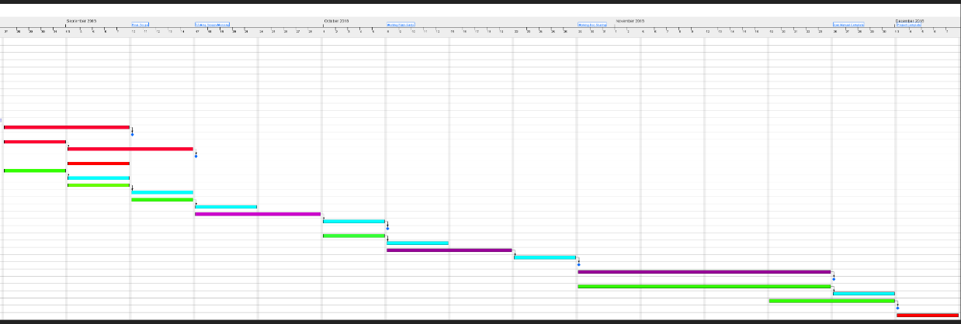
Schedule

Slide 12
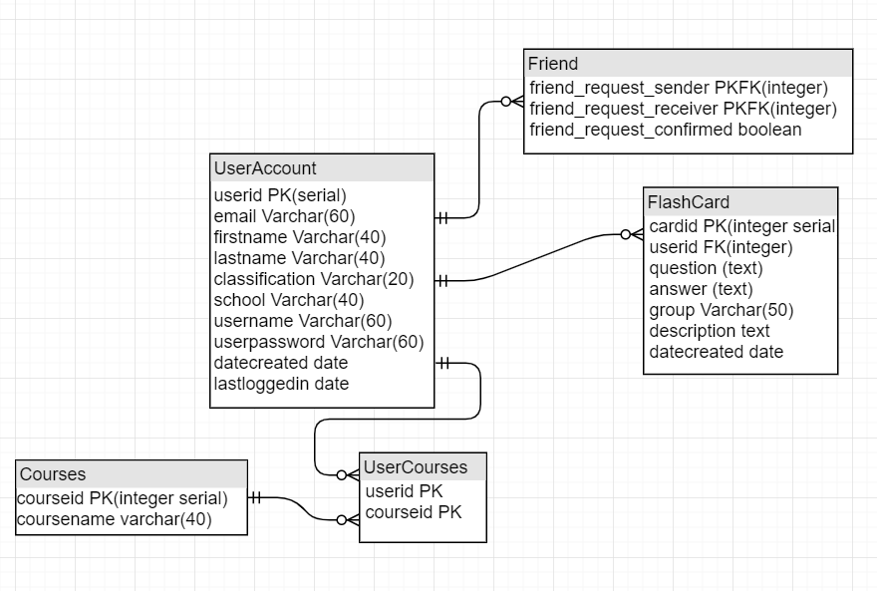
Database design

Slide 13
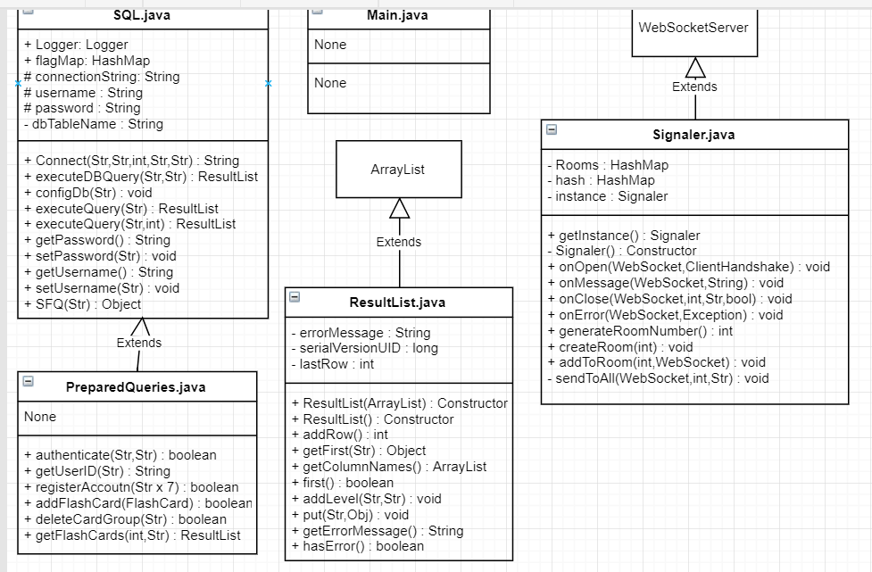
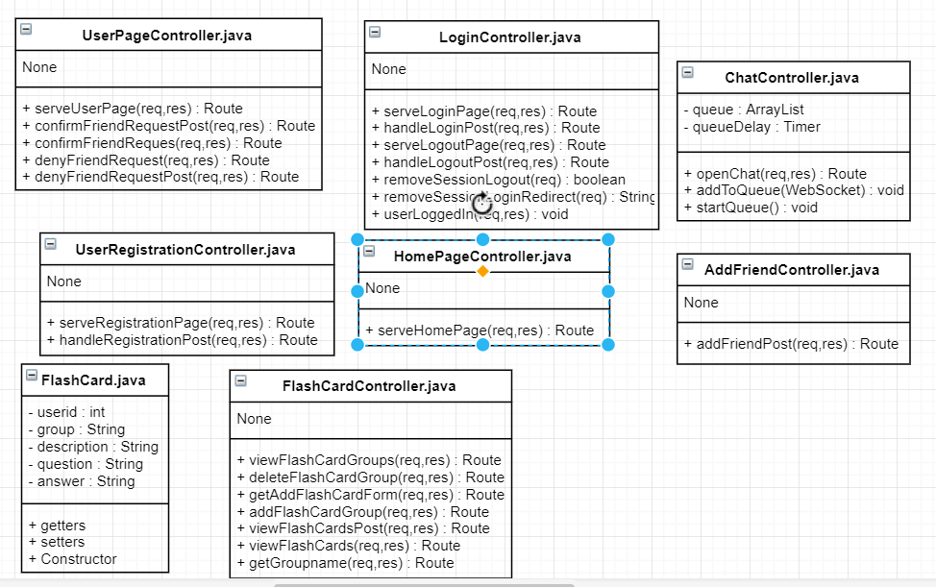
Design Class Diagram

Slide 14
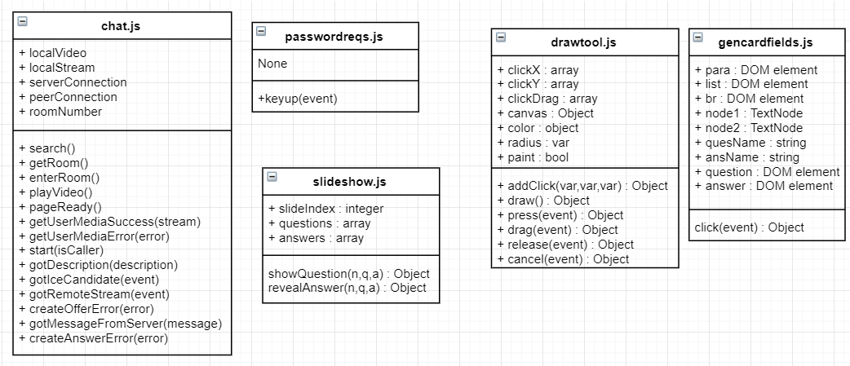
Design class diagram

Slide 15
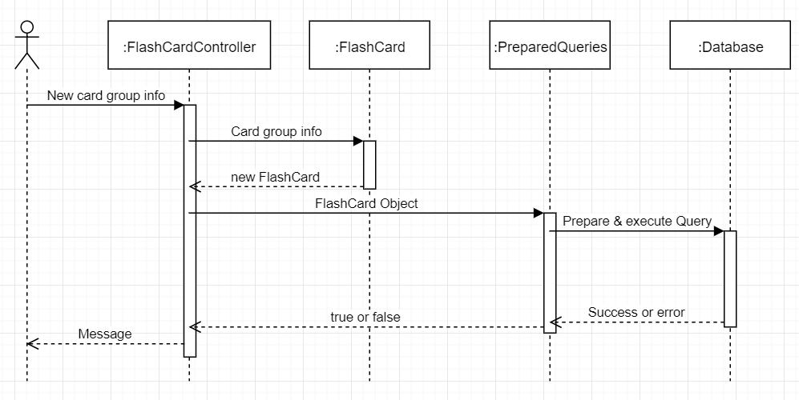
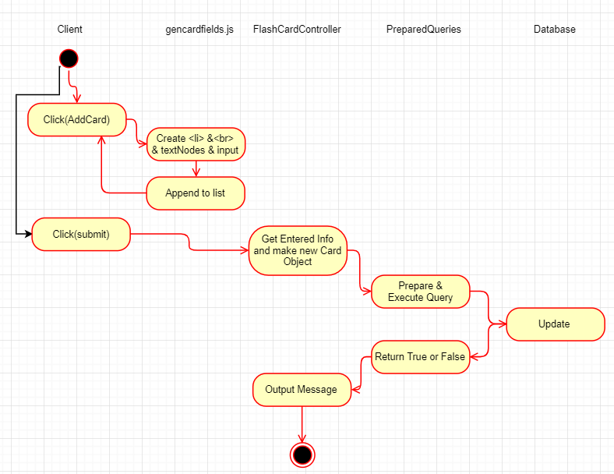
Flash card wizard Add Group

Slide 16
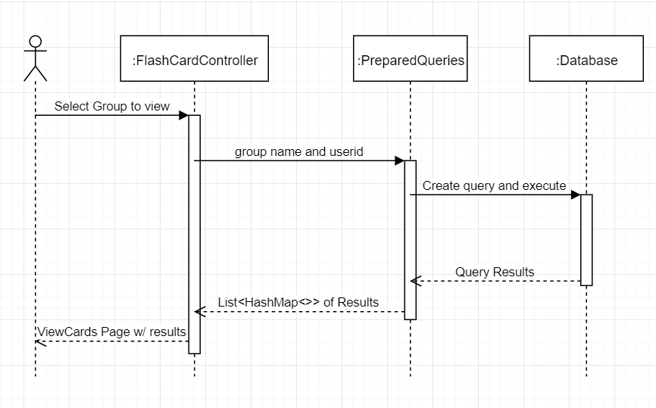
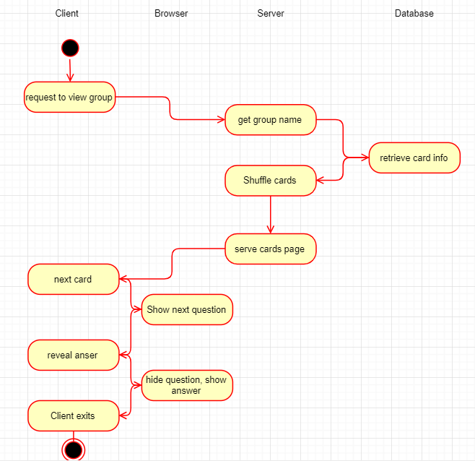
Flash card wizard view group

Slide 17
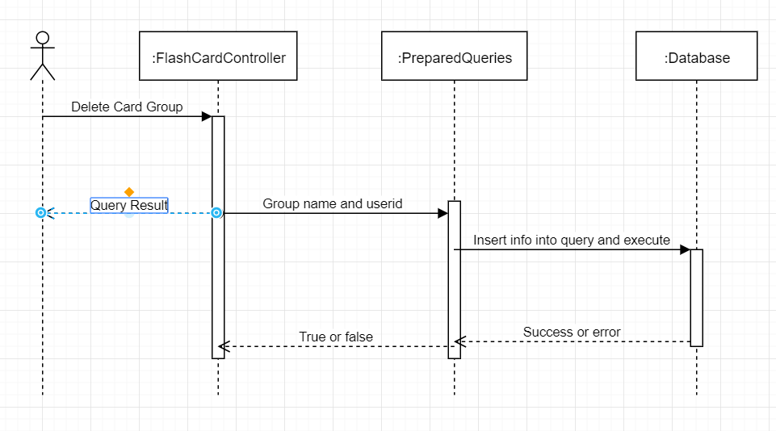
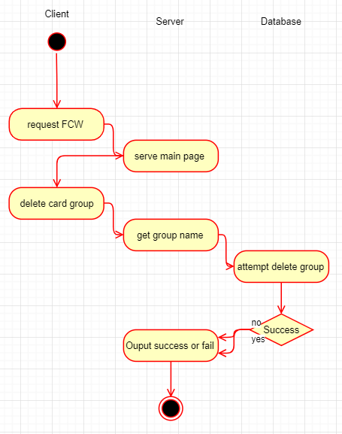
Flash card wizard delete group

Slide 18
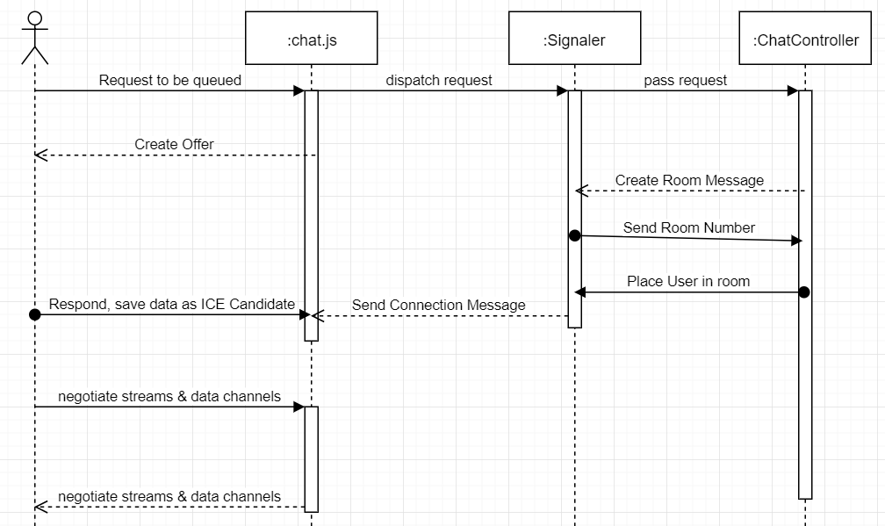
Video chat - sequence

Slide 19
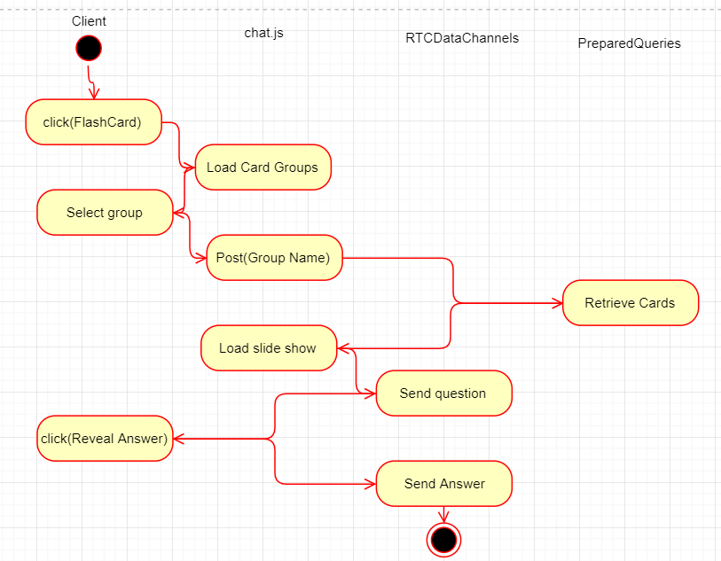
Video chat Flash cards

Slide 20
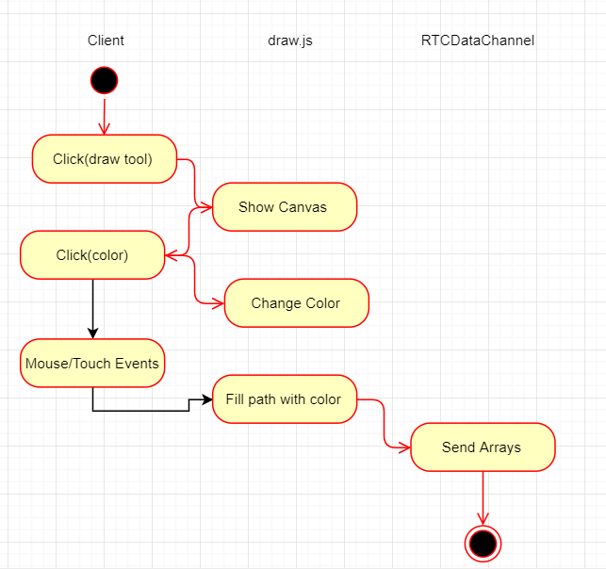
Video chat – draw tool

Slide 21
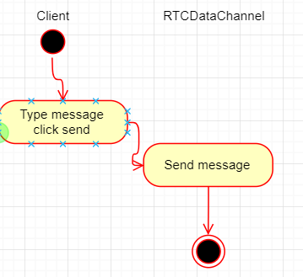
Video chat – text chat

Slide 22
Conclusion – prototype presentation

